Slide 1
Predicting Diabetes With a Neural Network
David Culhane

Slide 2
Problem & Project Goal
Problem
Project Goal
Diabetes diagnosis requires testing that can take long periods of time
Many people don’t have the ability to take tests due to the time requirement
Diabetes diagnosis is crucial for those becoming insulin resistant (Type 2)
Construct a neural network model to help doctors diagnose patients with diabetes
Model predictions would be intended to help diagnosis, not become the sole basis of diagnosis

Slide 3
About the Data
Data Found on Kaggle at: https://www.kaggle.com/datasets/iammustafatz/diabetes-prediction-dataset
Full dataset contains real, anonymized medical data of 100,000 patients
Fields include age, gender, hypertension diagnosis, heart disease diagnosis, smoking status, BMI, blood glucose level, HbA1c level, and diabetes diagnosis
Target class (diabetes diagnosis) is imbalanced with 8,500 positive diabetes values

Slide 4
Data preparation
Data was split into training and testing sets of features and target data
15,000 rows for testing set
Categorical fields were one-hot encoded
Numerical fields were converted into z-scores
Used function to apply to specified columns
Categorical fields stayed Boolean
Training and Testing objects were converted into tensors for modeling

Slide 5
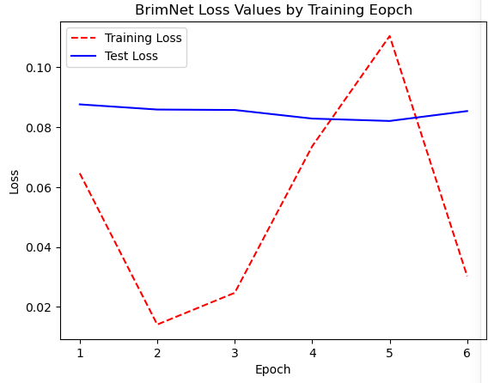
Modeling the Data
BrimNet was created using PyTorch
Input layer contained 15 neurons for Linear transformation
Hidden layers each contained 24 neurons
Hidden layer pairs consisted of Linear transformation and ReLU activation functions with 24 neuron inputs and outputs
Output layer consisted of a (24,1) sigmoid function to convert to a single probability
Batch Size of 50 samples
Determined 2 epochs were best for training

Slide 6
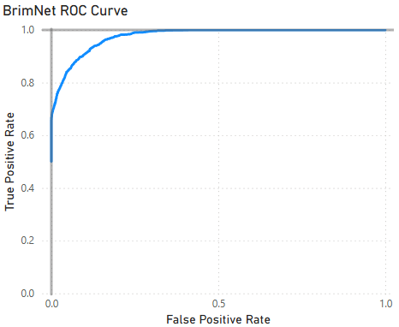
Evaluating the Model: ROC Curve
Calculates TP and FP rates at series of threshold values
Plot quickly approaches upper-left corner

Slide 7


Evaluating the Model: metrics
Scores found using Scikit-Learn metric functions
Classic Accuracy: 97.173
$\frac{TP+TN}{TP+TN+FP+FN}$
Recall: 65.9
Measures model’s ability to find all positive samples
$\frac{TP}{TP+FN}$
Precision: 100
Measures accuracy of positive diagnoses
$\frac{TP}{TP+FP}$
F1 Score: 79.4
Harmonic mean of Recall and Precision
$\frac{2 ∗TP}{\left(2 ∗TP\right)+FP+FN}$

Slide 8
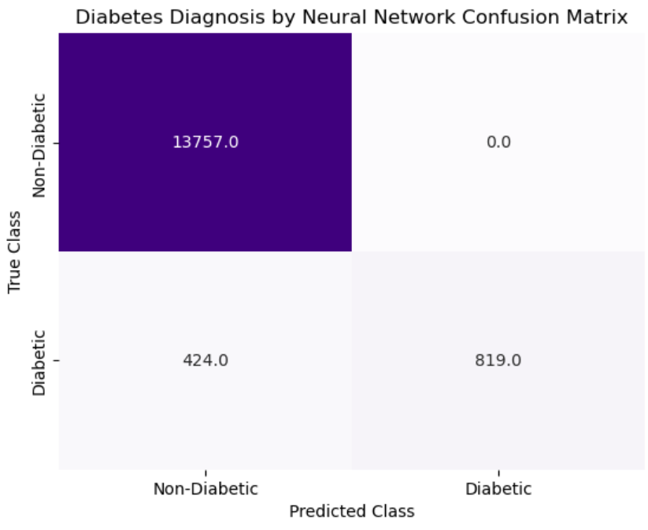
Evaluating The Model: Confusion Matrix
BrimNet perfectly diagnosed non-diabetics to not be diabetic
Accuracy for actual diabetics appeared to be around 66%
Recall score
Investigated False Negatives using summary statistics and violin plots

Slide 9
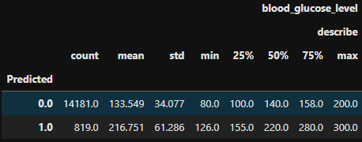
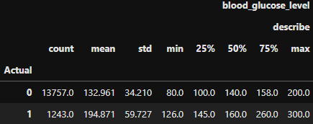
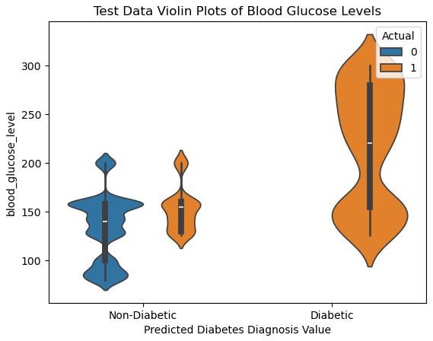
Breaking down the False Negatives: Blood Glucose Levels
False negative patients appear at the upper end of true negative blood glucose values
Quartile values for predicted diabetics higher than actual diabetics

Slide 10
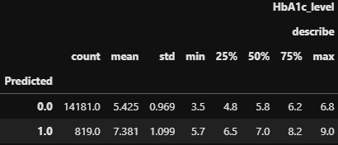
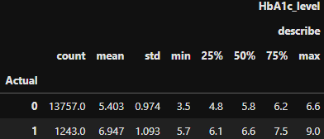
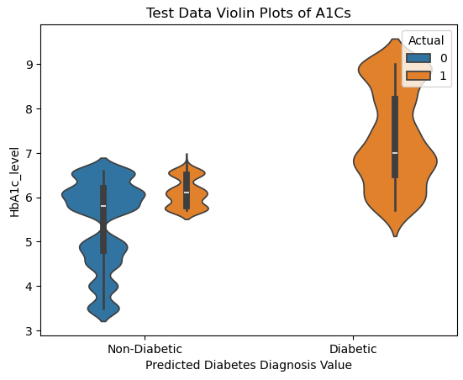
Breaking Down the False Negatives: A1C Values
False negative patients’ A1C values appear in the pre-diabetic range
Dataset did not specify if pre-diabetic patients were included in non-diabetic or diabetic populations
Quartile values for predicted diabetics higher than actual diabetics

Slide 11
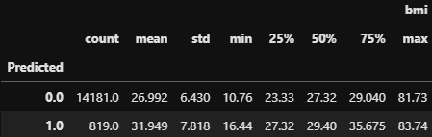
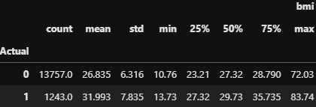
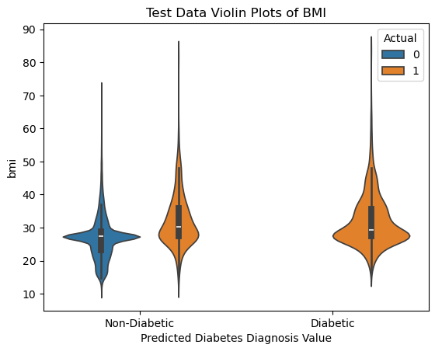
Breaking Down the False Negatives: BMI
False Negative patients’ BMI range is similar to true positive population
Quartile values similar for predicted and actual sets

Slide 12
Model Conclusions
BrimNet performed incredibly well with providing negative diagnoses to non-diabetic patients
Model would need to be refined further to decrease the false negative rate

